Slide 1

Case Study Analysis: NexusCart Online Shopping System
Presented By: Rajvardhan Deshmukh(43219)
Sakshi Gangurde(43224) Soham Gandhi(43223) Rishikesh Ghodke(43225)

Slide 2
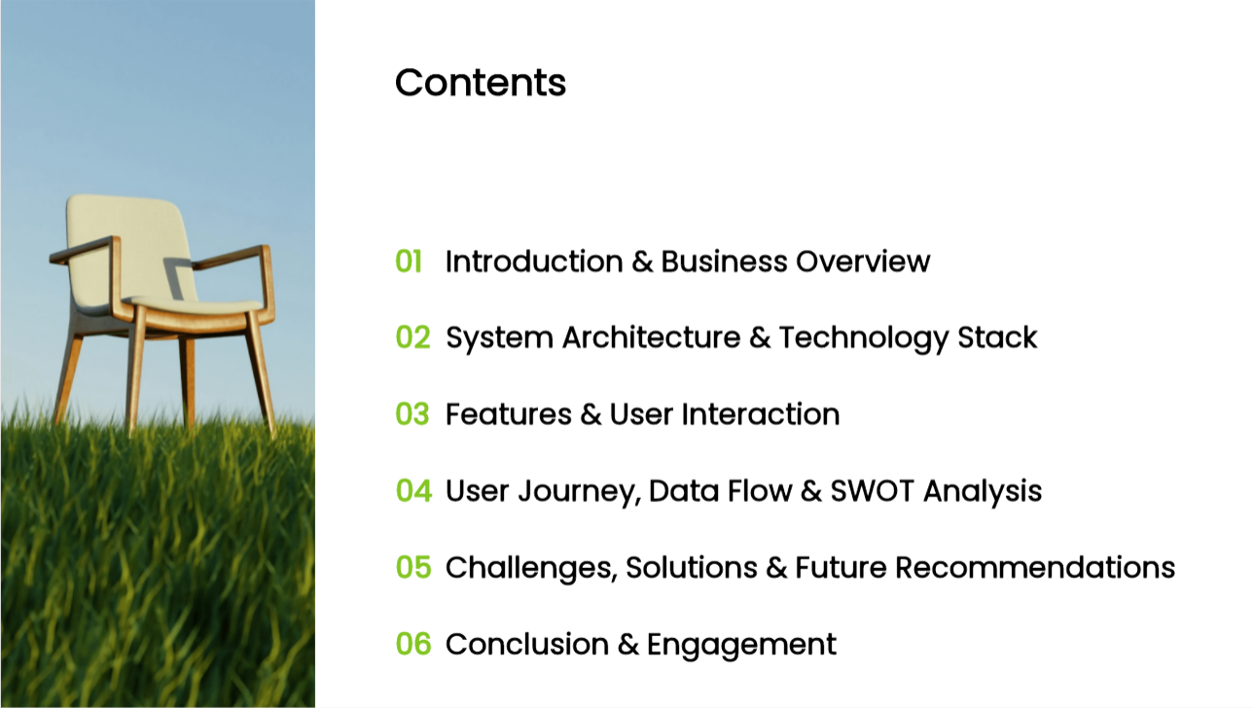

Slide 3


Slide 4
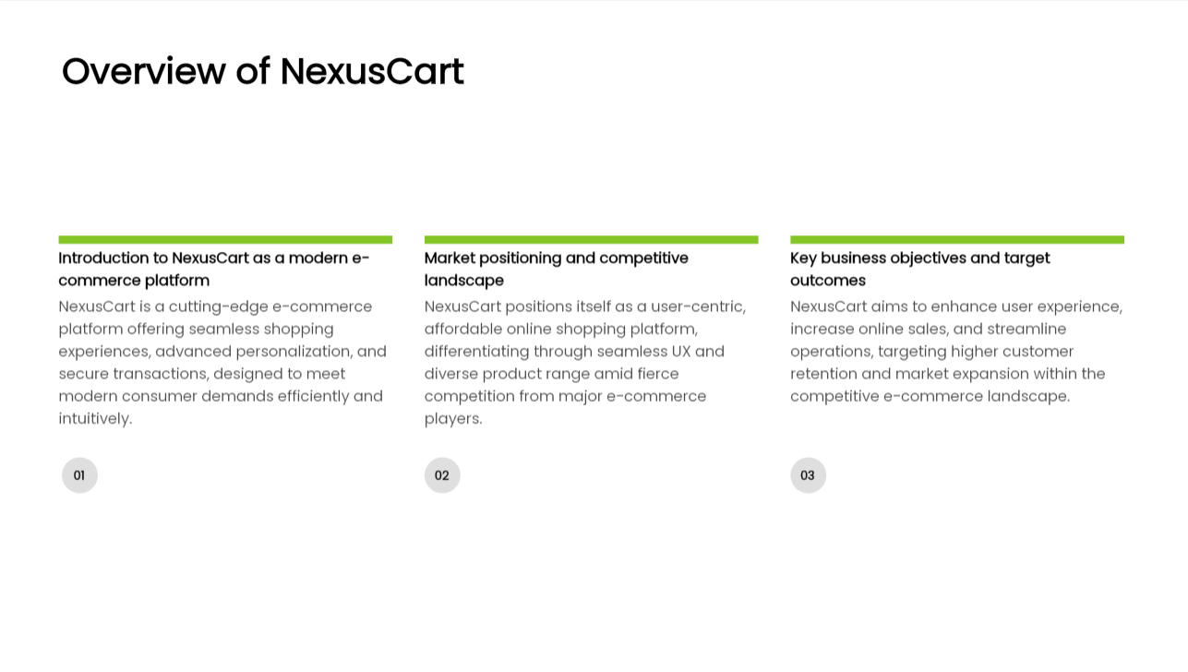

Slide 5
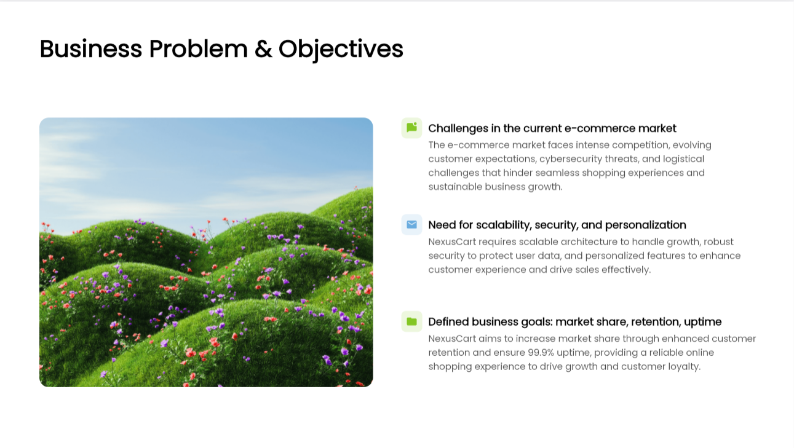

Slide 6
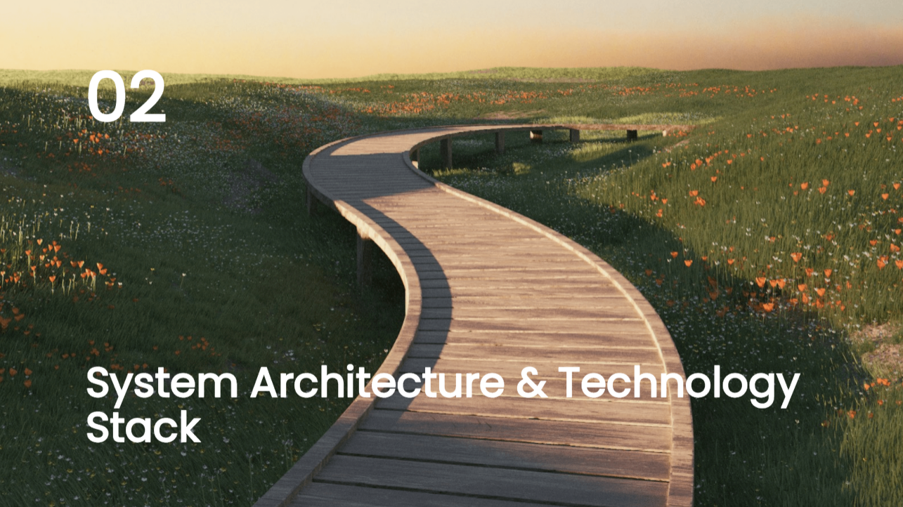

Slide 7
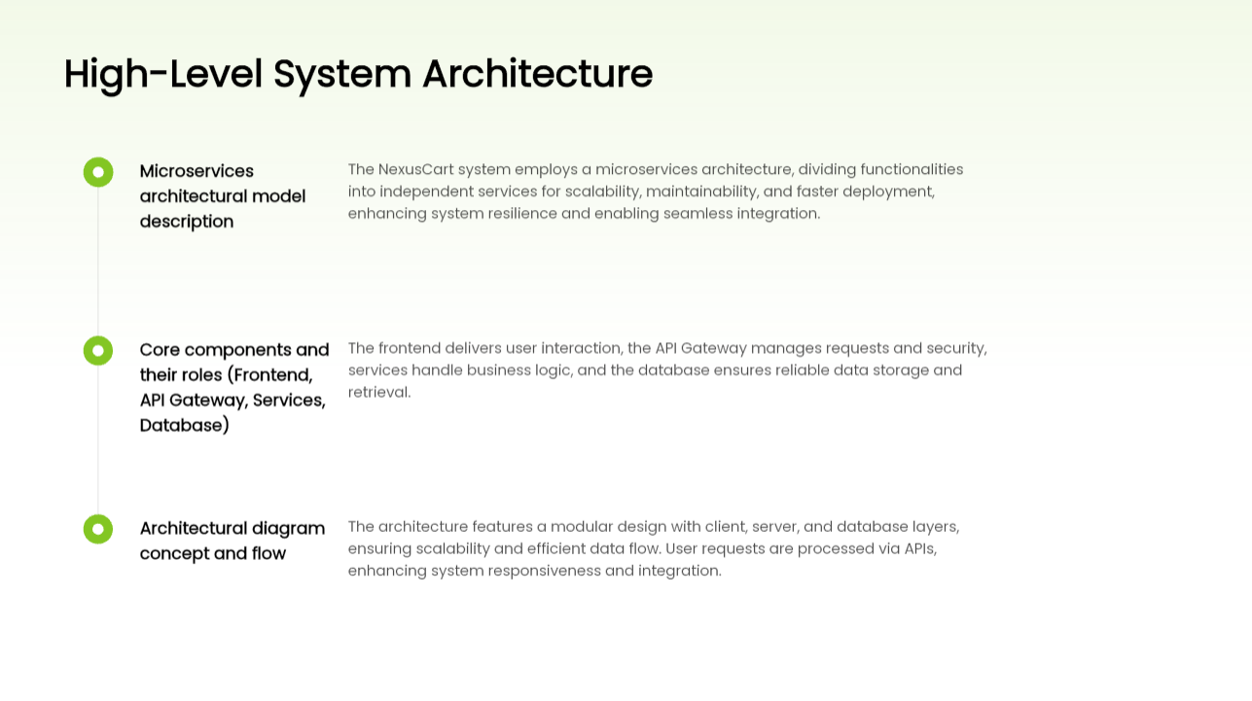

Slide 8
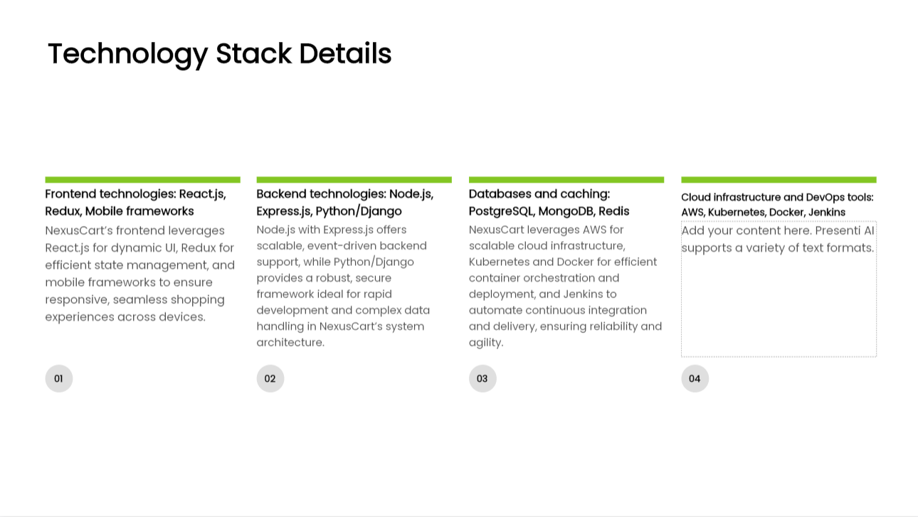







NexusCart leverages the AWS cloud to host its entire microservices architecture, ensuring high scalability, reliability, and global reach for its platform.

Slide 9


Slide 10
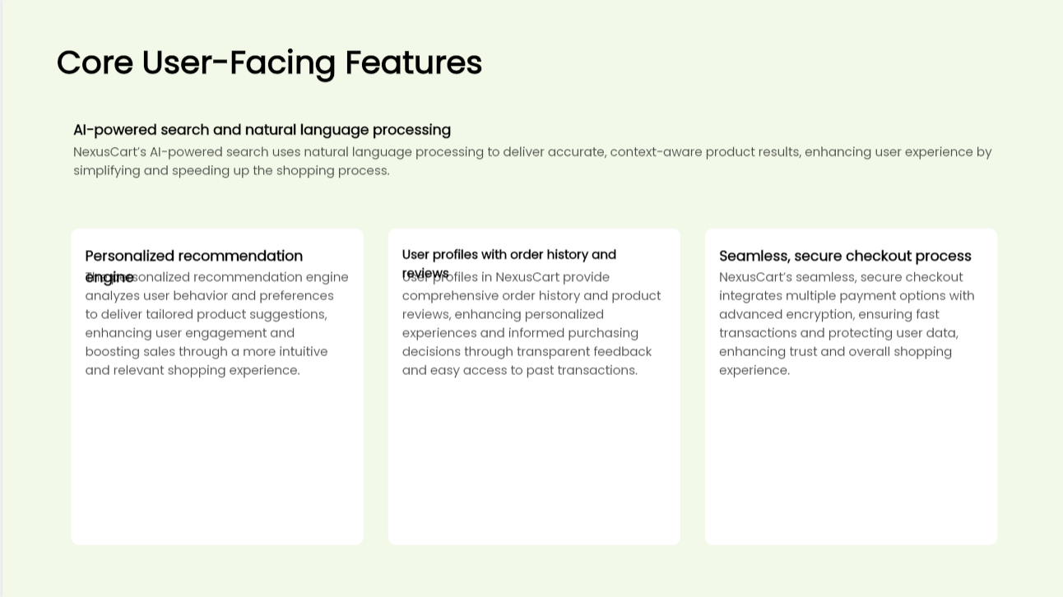

Slide 11
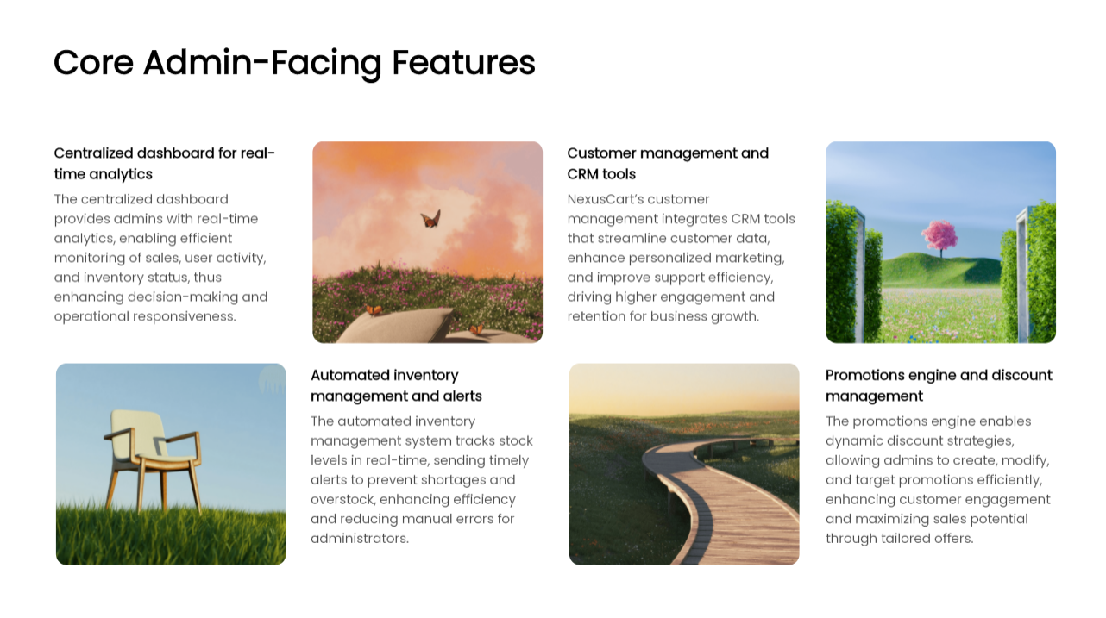

Slide 12


Slide 13
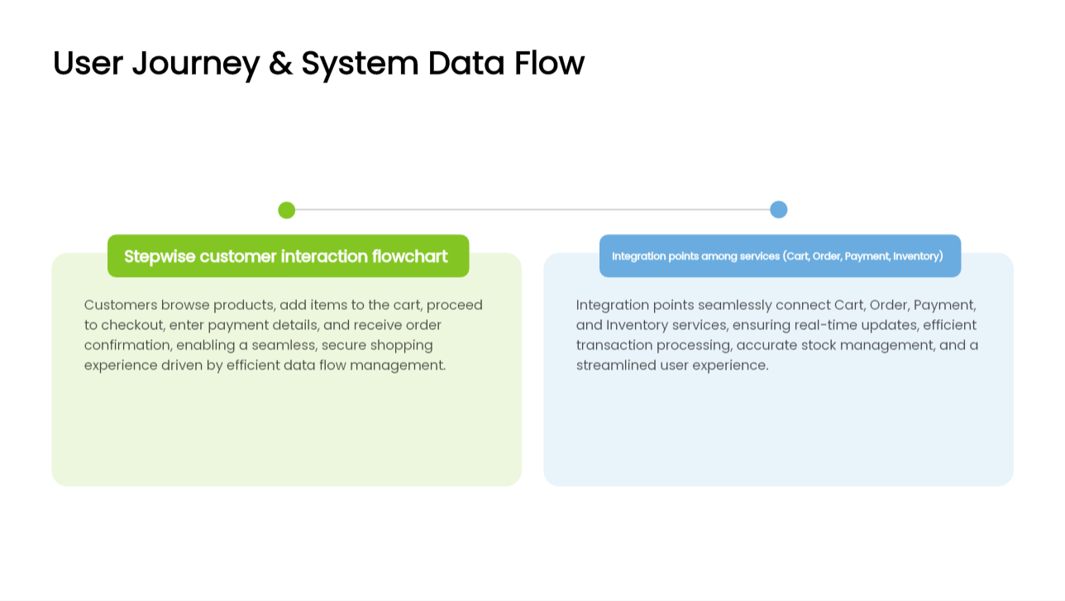

Slide 14
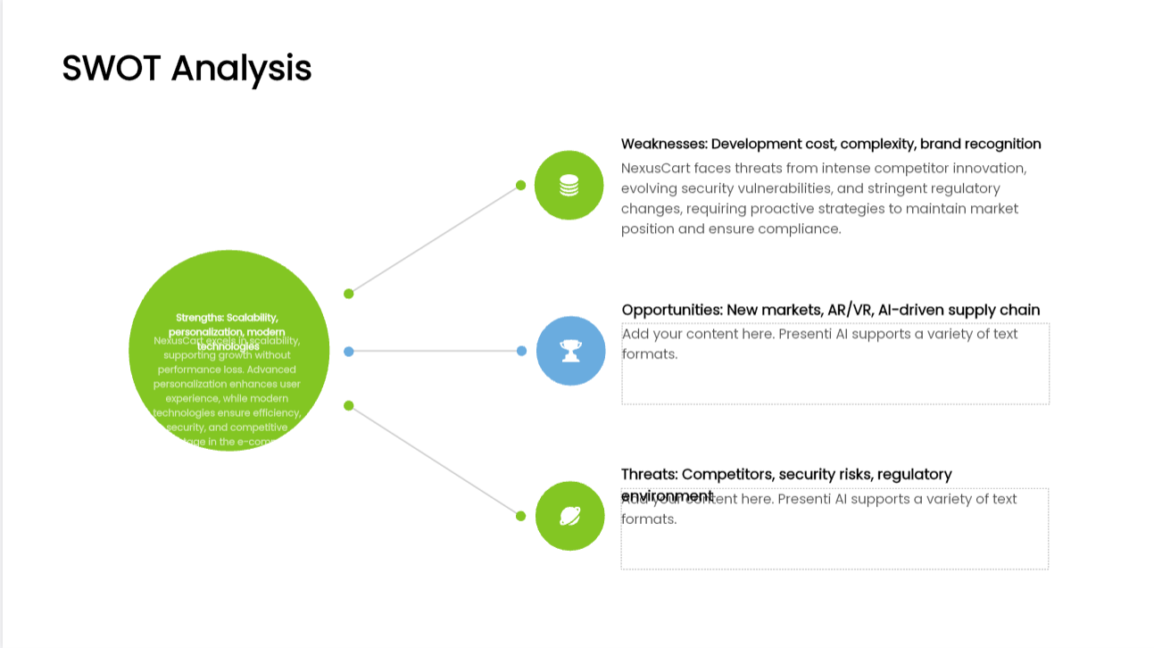

Slide 15


Slide 16
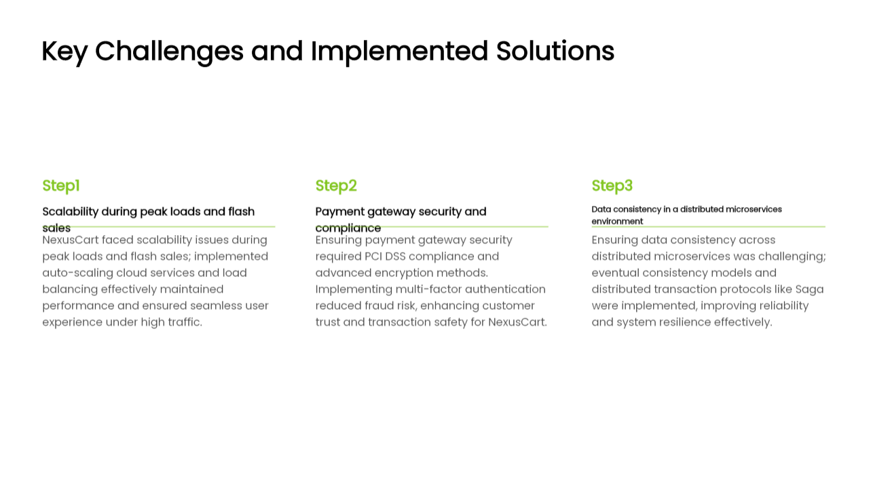

Slide 17
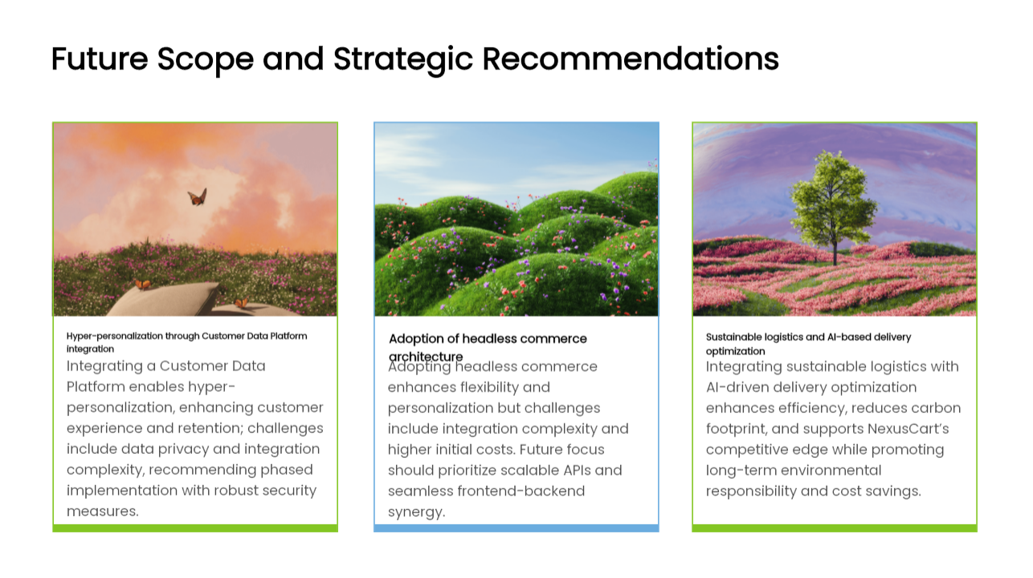

Slide 18


Slide 19
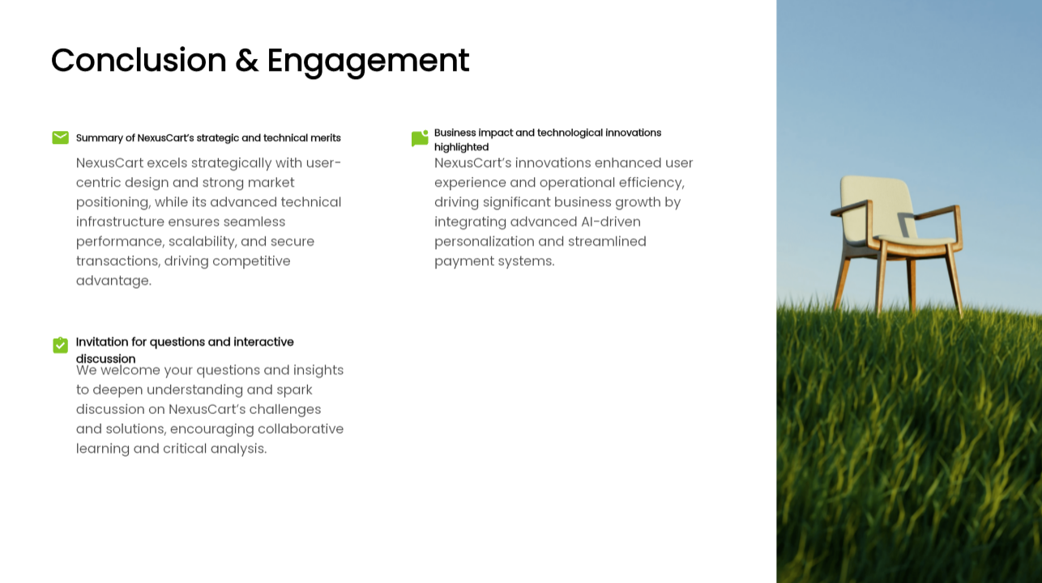

Slide 20


